Slide 1

Spotify Speed Dating
Nicholas Jefferis
Casey Schablein
Advisor: Yizong Cheng

Slide 2
What is it?
This project incorporates features from other popular social media apps and combines them to create a new, more effective way to discover new songs and artists, then easily transport these new discoveries back to Spotify.

Slide 3
Goals
01
02
03
04
Reimagine music discovery
Allow users to easily save new songs
Propagate sharing of music and playlists
Facilitate exposure of lesser known artists

Slide 4
Intellectual Merits
We created an innovative way to discover new music and artists
No tool combined all of the features such as seeding, personalization, rapid “swiping”, exporting, etc.

Slide 5
Broader Impact
Music is an integral aspect of human culture. Facilitating the discovery of new music and artists leads to widespread happiness. Not only does this product benefit its users, but also benefits the artists of any size or popularity releasing music. Promoting the sharing of music also promotes socialization.

Slide 6
Design Specifications
User logs in through Spotify and generates authentication token
Generate search seeds based on user input or listening history
Use search seeds to retrieve song recommendations from Spotify API
Play preview of recommended song and prompt users to swipe left or right
Blacklist left swiped songs, save right swiped songs to playlist
Allow user to export playlist of liked songs back to Spotify

Slide 7
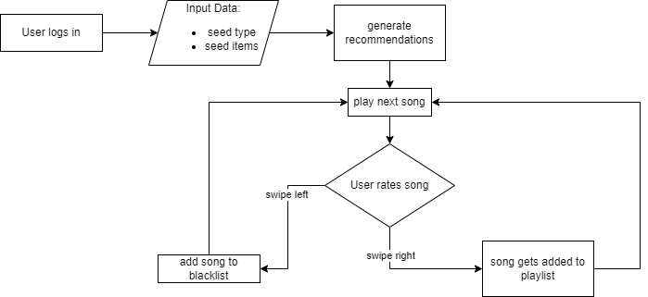
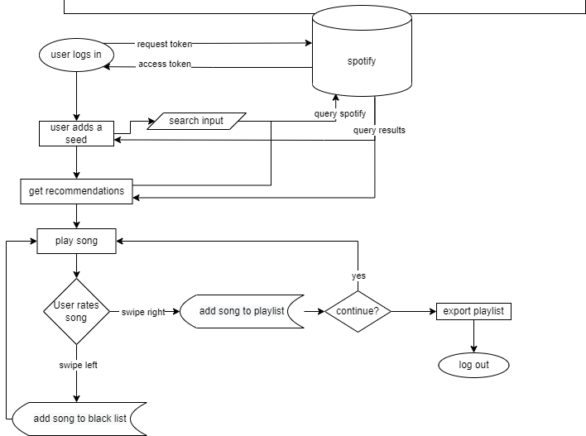
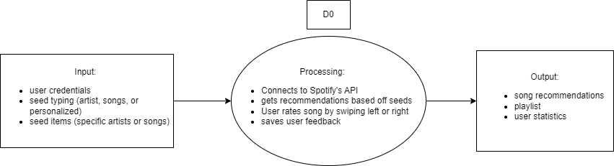
Design Diagrams

Slide 8





Technology
React
Spotify API
Dev Tools
We utilized React during every step of the development process. It allowed us to build out our web app piece by piece, component by component.
Spotify’s API is crucial to this project. After requesting an access token, we can use the API to retrieve personal top items, search for songs and artists, get recommendations, preview songs, and create playlists to share with anyone.
These development tools made it possible to create this project. VS Code was used for all the coding. GitHub was used for source control. NodeJS allowed us to test and run our project on our local machines.

Slide 9
Milestones
September 30, 2022
October 16, 2022
November 29, 2022
App creation and Spotify Authentication
Query Spotify for songs. Implementation of seeding
Generate and retrieve song recommendations based on seeds
December 1, 2022
December 15, 2022
December 20, 2022
Play song previews through embedded audio player
Implemented the “swiping” feature to rate and save song previews
Created the playlist preview and playlist exporting

Slide 10
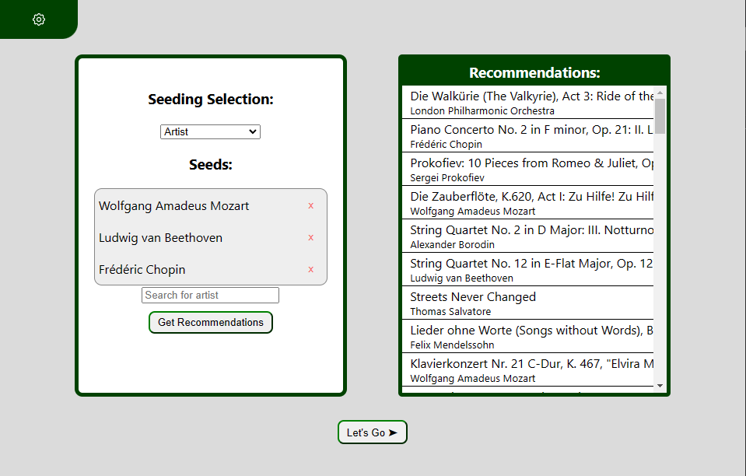
Results
Authentication
Audio
Seeding
Users receive authentication tokens for the duration of the session
Find preview links through Spotify song data and filter out songs without previews
Users can seed by favorite or individually searched songs and artists
Future Work
Analysis on songs, artists and genres liked by users
Implement more testing
Utilize cookies
Generate playlist links
More settings filters
Swiping
While previewing songs returned by the search, users can swipe right or left to like or dislike a song

Slide 11
Challenges
Spotify Developer Policy
Information Security Concerns
Experience
We had to follow the Spotify Developer Policy and Design Guidelines to avoid improperly using music and other content. This has limited us from easily sharing our project with friends and family.
With limited user authentication experience, we kept user information safe when logging in through Spotify by limiting access tokens to the duration of the session.
We chose this project as we have limited experience developing web applications, especially with React. This gave us an opportunity to expand our knowledge, but led to more initial challenge.

